Slide 1
Airmech Data Analytics
- Su YANG

Slide 2
Core ideas
Collect monetization and in-game behavior data.
Predict the likelihood a player is going to leave the game, understand why and make decisions accordingly.

Slide 3
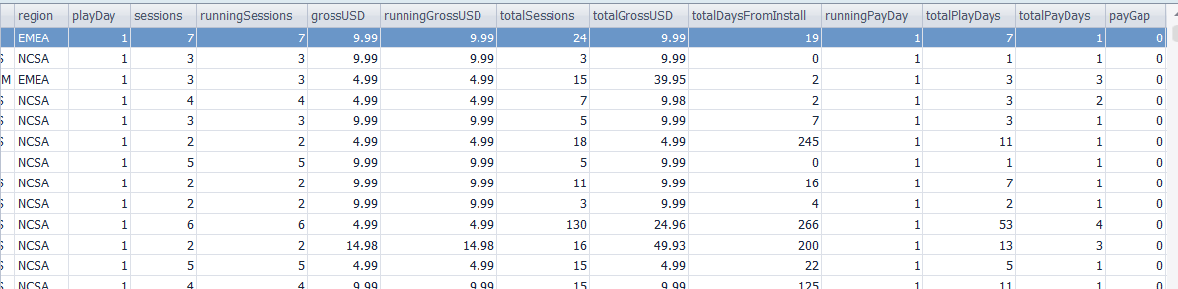
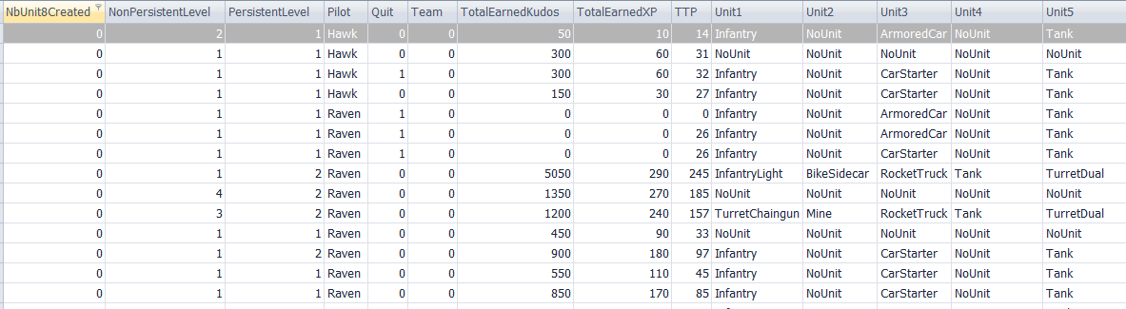
Where the data come from
Monetization data (27 columns, 6742683 rows)
In-game behavior data (53 columns, 49203678 rows)

Slide 4
Parameters: Which ones to use
80 potential parameters.
Not all influence the outcome of the algorithm.
Too many parameters used will overfit the model.
This first step needs market intelligence and understanding of players’ psychology.
1/3 of parameters have been dropped/altered.

Slide 5
Scope of the data
level 3 or up (77% of all players).
Players who stops playing a week later are considered Leavers.
We train/test the algorithm on old gen data, and make predictions on the new gen data

Slide 6
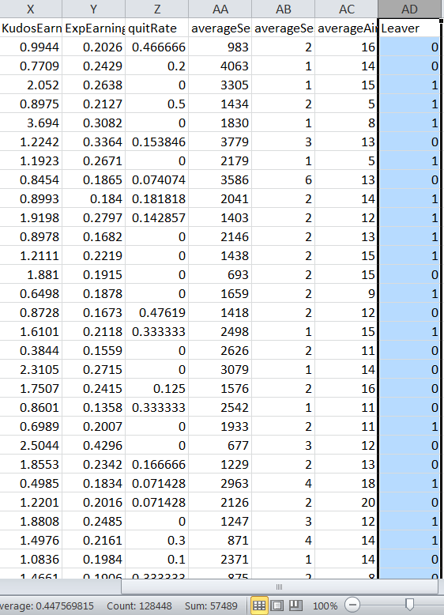
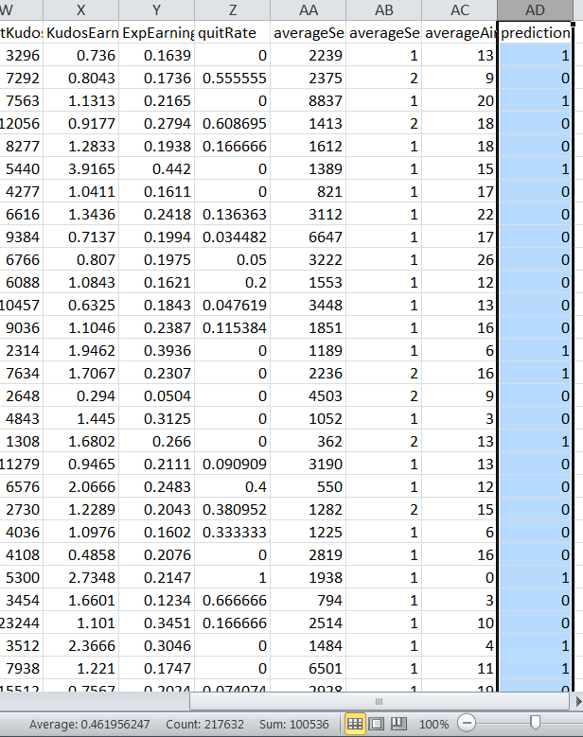
How the data look like
44.8% leavers on old gen, 46.1% predicted to be on new gen.
F-score = 0.64 (industry level = [0.5,0.7].
Old
gen
New gen

Slide 7
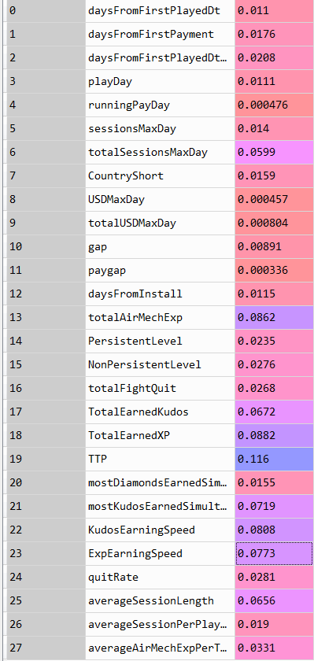
What the process taught us
Metrics used Weights on outcome
total time played is the most important metrics.
In other words, if a player starts to play less, he’s likely to leave soon (no surprise there).
TTP has the most influence

Slide 8
What the process taught us
Metrics used Weights on outcome
mostKudosEarnedSimultaneously is surprisingly a key factor.
Interepretation: I realize this is the casino psychology. Players expect an extremely high reward when playing
How to utilize?: -> crazy Wednesday for random high reward?
In the top five

Slide 9
What the process taught us
Metrics used Weights on outcome
The total time played is the most important metrics. In other words, if a player starts to play less, he’s likely to leave soon (no surprise there).
The mostKudosEarnedSimultaneously is a key factor, and the process lead us to realize it and understand the casino psychology of the players expecting an extremely high reward when playing -> crazy Wednesday for random high reward?
Average session length is also a good indicator and it speaks of the interest a player shows whenever he plays: In other words, dramatic drops in average session length begs reactions. On a related note, the total sessions (therefore average total session over time) is also contributing to the final results.
The Kudos and Exp earning speed are also important: Here it is tricky to understand that it is not a design influence but rather a player behavior indicator: the faster a player plays, the faster they gather Kudos/Exp, and the more interests they show to the game
Etc…

Slide 10
What the process taught us
Metrics used Weights on outcome
The total time played is the most important metrics. In other words, if a player starts to play less, he’s likely to leave soon (no surprise there).
The mostKudosEarnedSimultaneously is a key factor, and the process lead us to realize it and understand the casino psychology of the players expecting an extremely high reward when playing -> crazy Wednesday for random high reward?
Average session length is also a good indicator and it speaks of the interest a player shows whenever he plays: In other words, dramatic drops in average session length begs reactions. On a related note, the total sessions (therefore average total session over time) is also contributing to the final results.
The Kudos and Exp earning speed are also important: Here it is tricky to understand that it is not a design influence but rather a player behavior indicator: the faster a player plays, the faster they gather Kudos/Exp, and the more interests they show to the game
Etc…

Slide 11
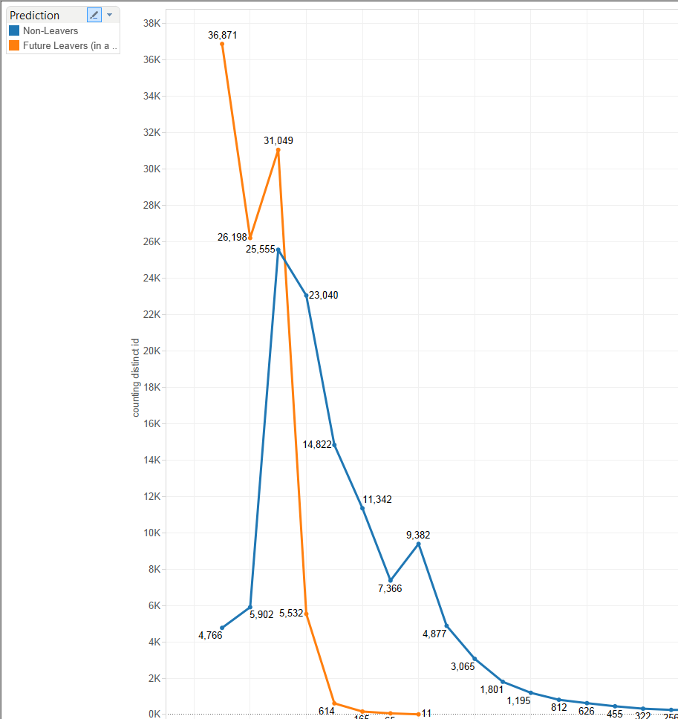
New achievement?
Pic on level 3 and 5 for future leavers.
Need new achievement for better retention rate.
The level 5 is a cap, need to find a way to make players reach 6.

Slide 12
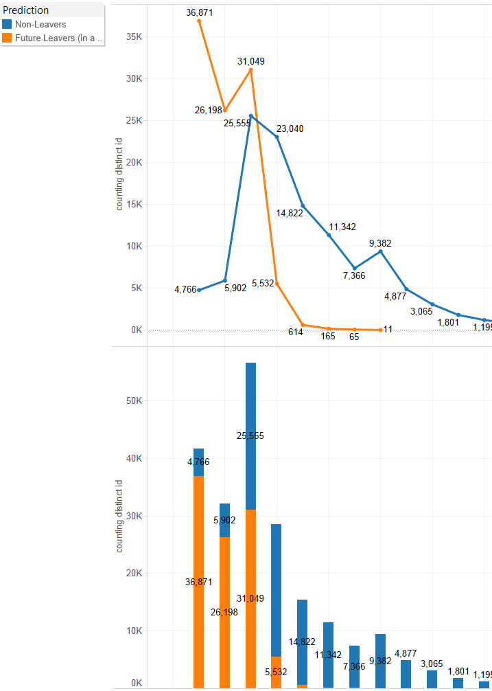
Level distribution
Among predicted leavers: 93.6% have less than level 5.
One more level at level 5: increase from 45.1% to 80.6% likelihood to keep playing.

Slide 13
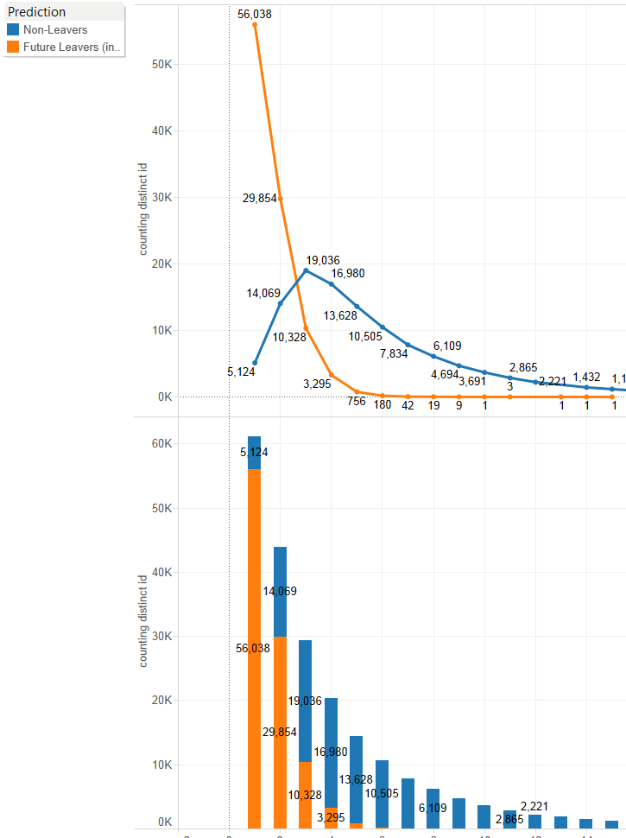
One more session?
Leavers curve is steeper than standard curve.
95.7% of leavers play less than 3 sessions (roughly 1 every 5 days).
One more session at 3 session: increase from 64.8% to 83.7% likelihood to keep playing.

Slide 14
Philosophy of Data Science
Data Science is not:
creating the perfect algorithm;
using all available data to answer predict an outcome.
Data Science is:
understanding data better;
finding and creating relevant metrics;
thus analyze/understand/predict players’ behavior and make deterministic measures.
all this by improving algorithm’s efficiency.

Slide 15
Philosophy of Data Science
In other words, Data Science is the science of:
understanding the data.
finding the relationship between data and real world.
creating new/more robust metrics by using Machine Learning as a tool!
making better business decision upon better understanding of consumers’ behaviors.

